Slide 1
Artificial Intelligence
Course Code: CS-202
Topic: Uninformed Search Algorithms
Instructor: Habiba Arshad

Slide 2
Week-5
This week lecture will cover the following CLO:
CLO 2: . Implement artificial intelligence techniques and case studies

Slide 3
Uniform Cost Search
Uniform Cost Search (UCS) is a popular search algorithm used in artificial intelligence (AI) for finding the least cost path in a graph.
It is a variant of Dijkstra's algorithm and is particularly useful when all edges of the graph have different weights, and the goal is to find the path with the minimum total cost from a start node to a goal node.

Slide 4
Uniform Cost Algorithm
Insert the root into the queue
While the queue is not empty
Dequeue the maximum priority (minimum cost)element from the queue
(If priorities are same, alphabetically smaller path is chosen)
If the path is ending in the goal state, print the path and exit
Else
Insert all the children of the dequeued element, with the cumulative costs as priority
Note: Example solved in class

Slide 5
Problem Statement
Imagine you are in a city and want to travel from your home (Node A) to a friend's house (Node G). The city map is represented as a graph where nodes are locations and edges are roads with associated travel costs (e.g., distance, time, or fuel).

Slide 6
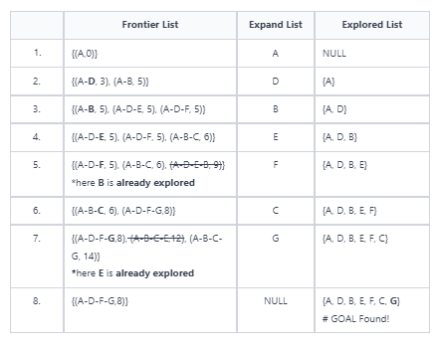
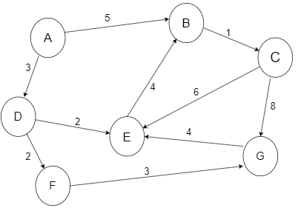
Uniform Cost Example

Slide 7
Step | Expanded Node | Queue Before Expansion (Cost, Node) | Neighbors Added / Updated | Queue After Expansion (Cost, Node)
1 | Start at A (0) | [] | Expand A → B (5), D (3) | [(3, D), (5, B)]
2 | D (3) | [(3, D), (5, B)] | Expand D → E (5), F (5) | [(5, B), (5, E), (5, F)]
3 | B (5) | [(5, B), (5, E), (5, F)] | Expand B → C (6), E (9) (but E already has 5) | [(5, E), (5, F), (6, C)]
4 | E (5) | [(5, E), (5, F), (6, C)] | Expand E → C (11), G (9) | [(5, F), (6, C), (9, G)]
5 | F (5) | [(5, F), (6, C), (9, G)] | Expand F → G (8) → update G (9 → 8) | [(6, C), (8, G)]
6 | C (6) | [(6, C), (8, G)] | Expand C → G (14), but G already has 8 | [(8, G)]
7 | G (8) | [(8, G)] | Goal reached | Finished

Slide 8
Uniform Cost Search
Advantages
Guarantees optimality and completeness.
Works with weighted graphs.
Disadvantages
High time and space complexity.
Inapplicable to negative edge costs.
No heuristic guidance, making it less efficient.
Not suitable for real-time or time-sensitive applications.

Slide 9
Bidirectional Search
Bidirectional Search is Graph Search Algorithm where two graph traversals (BFS) take place at the same time and is used to find the shortest distance between a fixed start vertex and end vertex.
It significantly reduces the amount of exploration done. It is implemented using the Breadth First Search (BFS) Algorithm.
BFS is run simultaneously on two vertices - the start and the end vertex. One single BFS tree is now replaced by two sub trees, and the search is terminated when the two trees intersect.

Slide 10
Bidirectional Search Algorithm
Start(Q) = Queue for BFS from start node
End(Q) = Queue for BFS from end node
parent= Array where startparent[i] is parent of node i
visited= Array where visited[i]=True if node i has been encountered
while start(Q) is not empty and end(Q) is not empty
perform next iteration of BFS for start(Q) (also save the parent of children in parent array)
perform next iteration of BFS for end(Q)
if we have encountered the intersection node
save the intersection node
break
using intersection node, find the path using parent array

Slide 11
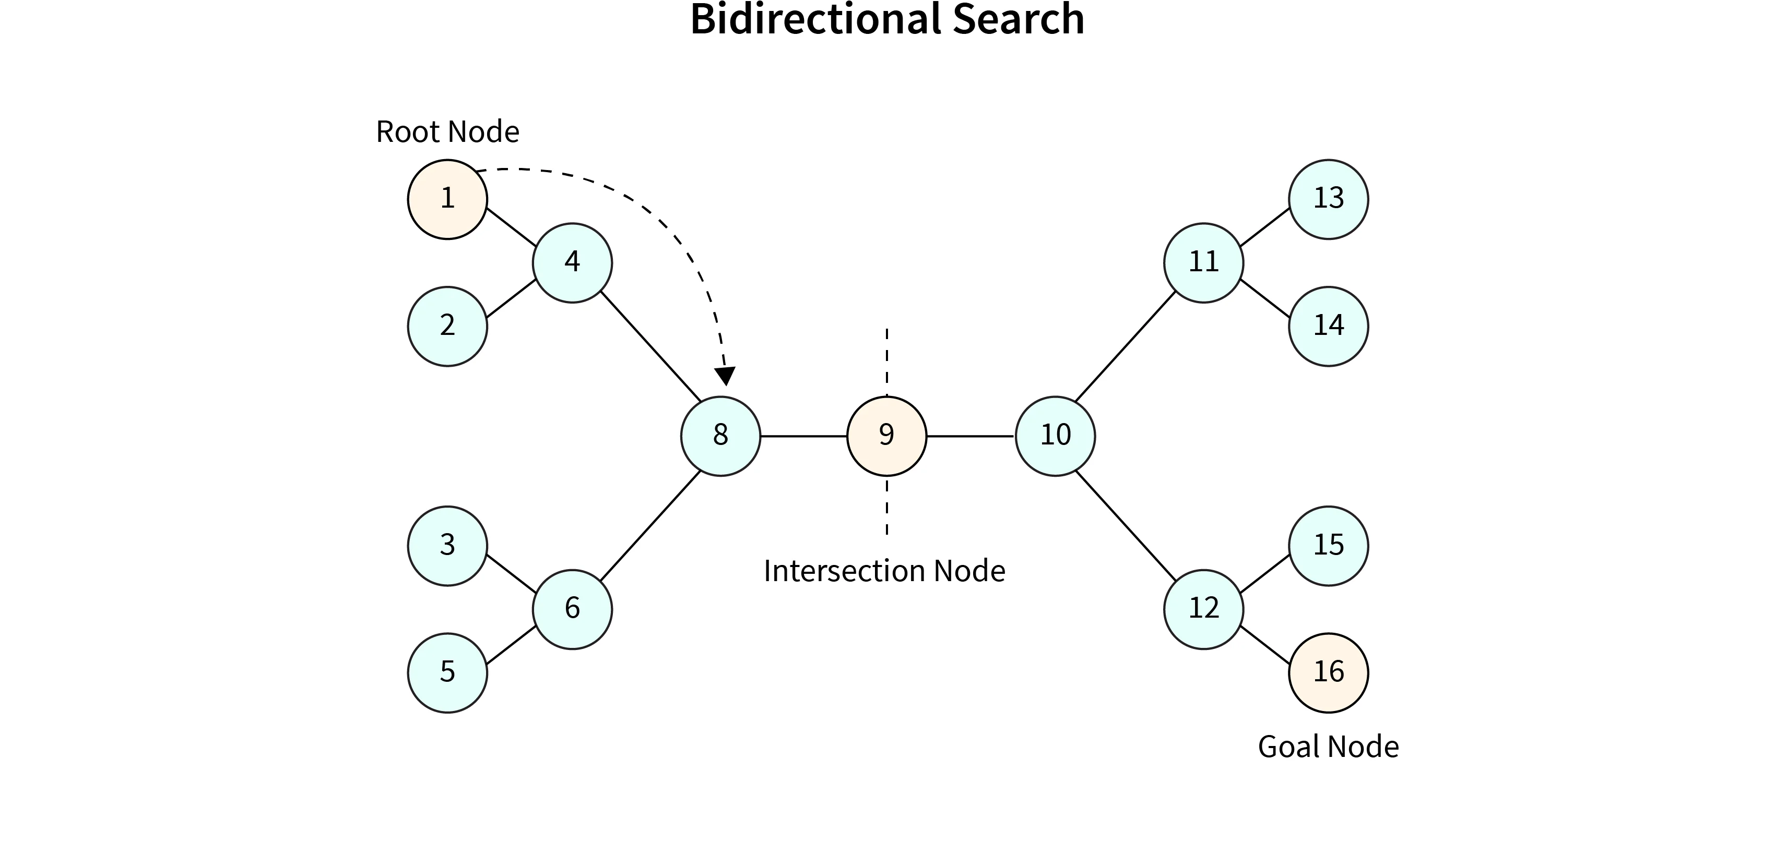

Slide 12
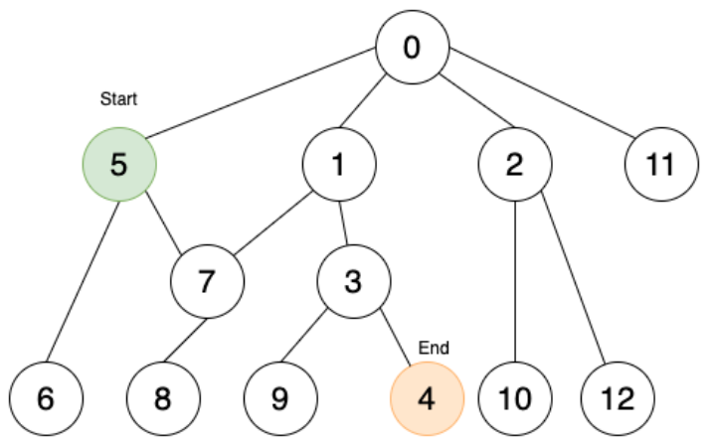
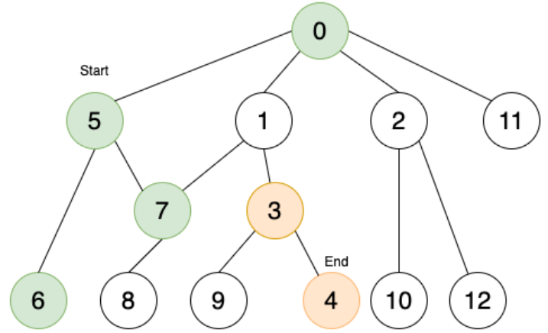
Bidirectional Search Example
Similar to BFS, at every point explore the next level of nodes till you find an intersecting node.
The start node is 5 and the end node is 4. Aim: To find the shortest path from 5 to 4 using bidirectional search.
Do BFS from both directions.
Start moving forward from start node (Green) and backwards from end node (Orange).

Slide 13
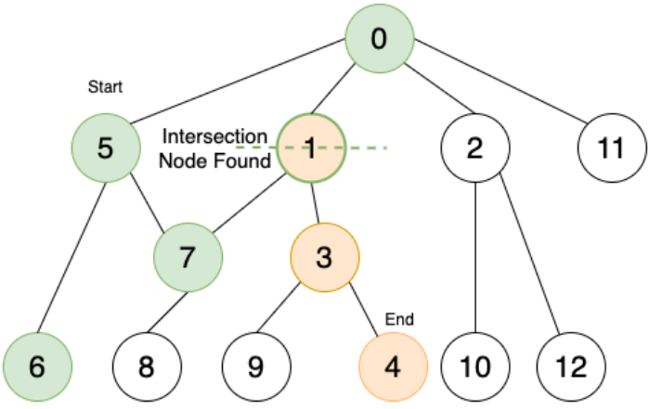
Bidirectional Search Example
Stop on finding the intersecting node.
Trace back to find the path
Path: 5 – 0 – 1 – 3 – 4

Slide 14
Bidirectional Search
Advantages
Reduced Search Space
Lower Time Complexity O(b^{d/2})
Memory Efficiency
Optimal Solution
Disadvantages
Requires Goal State to Be Known
Complex Implementation
Not Suitable for All Problem Types

Slide 15

Importance of Search in AI
Provides a systematic way to explore complex problem spaces.
Enables AI to solve a wide variety of problems (e.g., pathfinding, scheduling, game playing).
Forms the backbone of more advanced techniques like machine learning and planning.

Slide 16

Common Searching Algorithms
Uninformed Algorithms: BFS, DFS, Uniform Cost Search.
Informed Algorithms: Greedy Best-First, A* Search.
Other Techniques:
Iterative Deepening (combines depth-limited search with DFS).
Bidirectional Search (searches from both start and goal).

Slide 17

Heuristics in Informed Search
A heuristic is a problem-specific estimate that helps guide the search towards the goal.
Good heuristics can significantly reduce search time.
Examples: Manhattan distance in grid-based pathfinding, straight-line distance in navigation.

Slide 18

Comparison of Search Techniques
Efficiency, optimality, and completeness of each algorithm.
When to use uninformed vs. informed search.

Slide 19
Summary
Problem-solving agents use search techniques to find solutions.
Uninformed search explores the search space without extra information.
Informed search uses heuristics to guide the search process.
A* is a powerful informed search algorithm combining cost and heuristic estimates.

